Slide 1

NANDHA ENGINEERING COLLEGE ERODE – 52 (AUTONOMOUS)
Department of Artificial Intelligence and Data Science
Deepfake Audio Detection Using Self-Supervised Speech Embeddings and LSTM/BiLSTM Network
Guided By : Ms. M. Parvathi, M.E., Ph.D. Assistant Professor, AI & DS
Presented by :
ARAVINDHAN A(22AI002)
MADHAN V (22AI025)
PREM KUMAR R (22AI039)
Notes:
1

Slide 2
Contents
Introduction
Objective
Problem Description
Proposed System
Software Tools Used
Module Implementation
Screenshots
Literature Survey
References
Notes:
2

Slide 3
Introduction
Deepfake audio is artificially generated speech that closely mimics real human voices using advanced AI techniques like TTS and voice conversion.
The rapid growth of deep learning has made synthetic audio highly realistic and difficult to distinguish from real speech.
Deepfake audio poses serious threats such as identity theft, fraud calls, misinformation, and bypassing voice authentication systems.
Traditional detection methods like spectrogram-based models have limitations in accuracy and generalization.
Therefore, advanced techniques like self-supervised speech embeddings and LSTM/BiLSTM models are required for effective and reliable detection.
Notes:
2

Slide 4
Objective
To develop an efficient system for detecting deepfake audio using advanced deep learning techniques.
To utilize self-supervised speech embeddings for better feature extraction from audio signals.
To implement LSTM and BiLSTM models for capturing temporal patterns in speech.
To improve detection accuracy and generalization across different datasets and fake audio types.
To build a lightweight, real-time system using Streamlit for practical applications like cybersecurity and media verification.
Notes:
2

Slide 5
Problem Description
Rapid advancements in Text-to-Speech (TTS) and voice conversion technologies generate highly realistic synthetic audio, making detection challenging.
Existing methods such as spectrogram-based and CNN models fail to capture fine-grained temporal and phonetic characteristics of deepfake audio.
Current systems show poor generalization, leading to reduced performance on unseen datasets and new deepfake techniques.
Traditional approaches relying on handcrafted features are insufficient for identifying complex, high-level speech patterns.
There is a need for a lightweight, accurate, and real-time detection system for applications in cybersecurity, digital forensics, and media authentication.
Notes:
2

Slide 6
Proposed System
The proposed system uses a hybrid CNN + BiLSTM deep learning architecture to effectively detect audio deep fakes.
MFCC features are extracted from uploaded audio files and reshaped into a format suitable for deep learning.
CNN layers extract local spectral patterns, while BiLSTM layers analyze temporal speech dependencies in both forward and backward directions. The trained model predicts the probability of the audio being fake.
A Streamlit-based dashboard enables users to upload audio files, view waveforms, spectrograms, MFCC visualizations, confidence gauges, and generate downloadable HTML reports.
The system ensures accurate, automated, and user-friendly deep fake detection.
Notes:
2

Slide 7
Software / Tools Used
Python programming language – Used for developing, training, and deploying the deepfake detection system
TensorFlow / Keras deep learning framework – Used to build and train CNN and BiLSTM models
Mel Frequency Cepstral Coefficients (MFCC) – Extracted as primary audio features for classification
Convolutional Neural Network (CNN) – Used to learn spatial representations from MFCC features
Bidirectional Long Short-Term Memory (BiLSTM) – Used to capture temporal dependencies in speech signals
Librosa – Used for audio processing and MFCC feature extraction
NumPy – Used for numerical computations and data preprocessing
Streamlit – Used to develop an interactive web interface for audio upload and analysis
Notes:
2

Slide 8
Module 1: Audio Input
Description: This module allows the user to upload an audio file through a web-based interface.The system supports multiple audio formats such as WAV, MP3, OGG, FLAC, and M4A.Once uploaded, the audio is read and converted into a numerical format suitable for further processing by the deep learning model..
Techniques Used:
Python
Streamlit (Web Interface)
Notes:
2

Slide 9
Module 2: Audio Pre-processing
Description: The uploaded audio is pre-processed to ensure uniformity and noise robustness.The audio signal is resampled to a fixed sampling rate (e.g., 16 kHz) to maintain consistency.Optional noise reduction and normalization are applied to improve audio quality.The audio is trimmed or padded to a fixed length to ensure uniform input size for the model.
Techniques Used: In this module, Python libraries such as Librosa and NumPy are used to handle and process the audio signal efficiently.
Algorithms Used:
Basic audio signal-processing algorithms such as resampling, noise reduction, normalization, and trimming/padding are applied to make the audio uniform and suitable for feature extraction
Notes:
2

Slide 10
Module 3: Feature Extraction
Description: In this module, Mel Frequency Cepstral Coefficients (MFCC) are extracted from the pre-processed audio.MFCC features effectively capture the spectral and perceptual characteristics of human speech.The extracted MFCC features are reshaped into a suitable format to serve as input for the CNN and BiLSTM layers.
Technology Used: In this module, Python with Librosa and NumPy is used to extract and manage speech features from the pre-processed audio.
Algorithms Used: The MFCC (Mel Frequency Cepstral Coefficient) algorithm is applied to extract spectral features that represent important characteristics of human speech for deepfake detection.
Notes:
2

Slide 11
Module 4: Deep Learning Model Prediction (CNN + BiLSTM)
Description: This module performs deepfake audio classification using a hybrid CNN and BiLSTM model.CNN layers learn spatial patterns from MFCC feature maps, identifying local spectral artifacts introduced by synthetic speech.BiLSTM layers capture long-term temporal dependencies and sequential speech patterns, enabling effective discrimination between real and fake audio signals.The final output predicts whether the uploaded audio is genuine or deepfake.
Technology Used: In this module, Python with TensorFlow/Keras is used to build and execute the deep learning model, and Streamlit is used to display the prediction results to the user.
Algorithms Used: A Convolutional Neural Network (CNN) is used to learn spatial patterns from MFCC features, and a Bidirectional Long Short-Term Memory (BiLSTM) algorithm is used to capture temporal speech patterns and classify the audio as real or deepfake.
Notes:
2

Slide 12
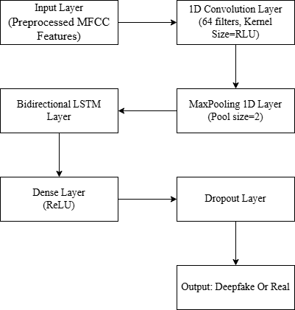
Module Implementation
System Block Diagram
Notes:
2

Slide 13
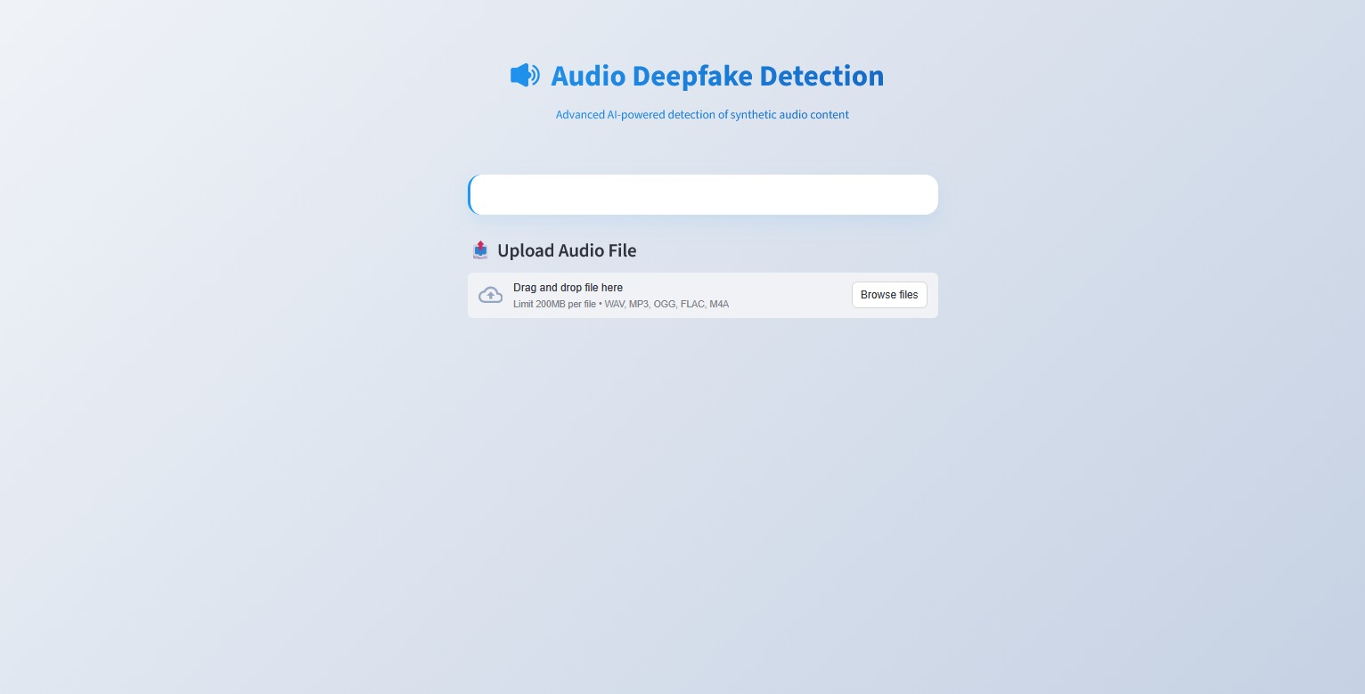
Screenshot
Dashboard
Notes:
2

Slide 14
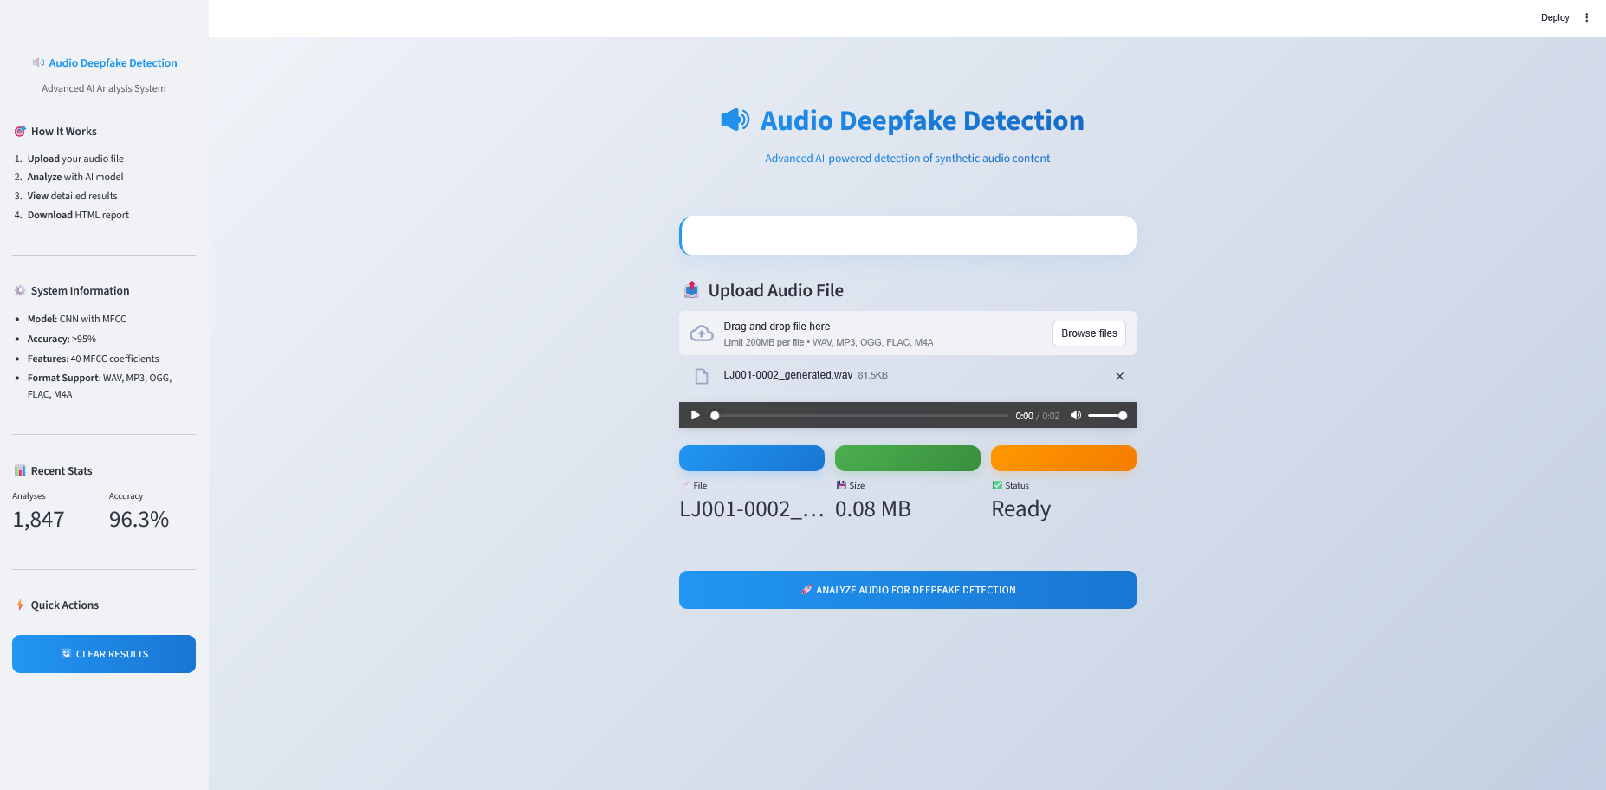
Screenshot
Dashboard
Notes:
2

Slide 15
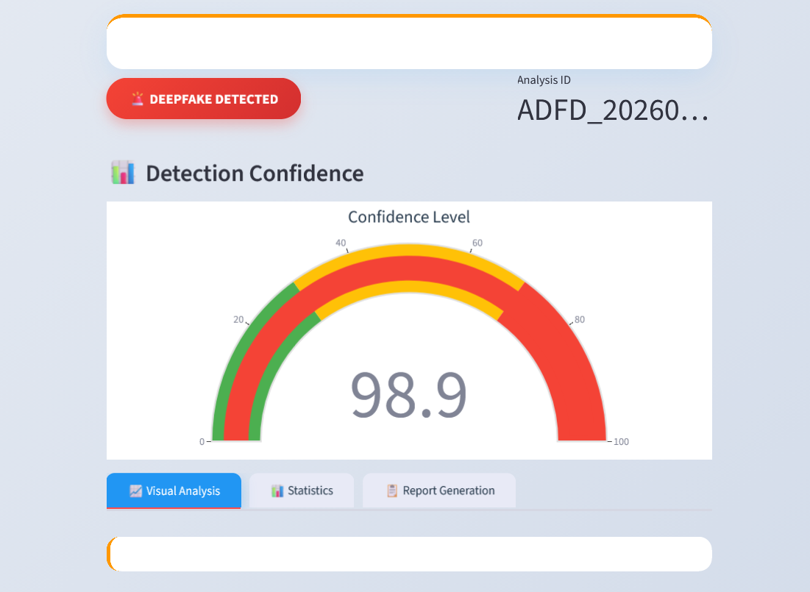
Screenshot
Ai Audio
Notes:
2

Slide 16
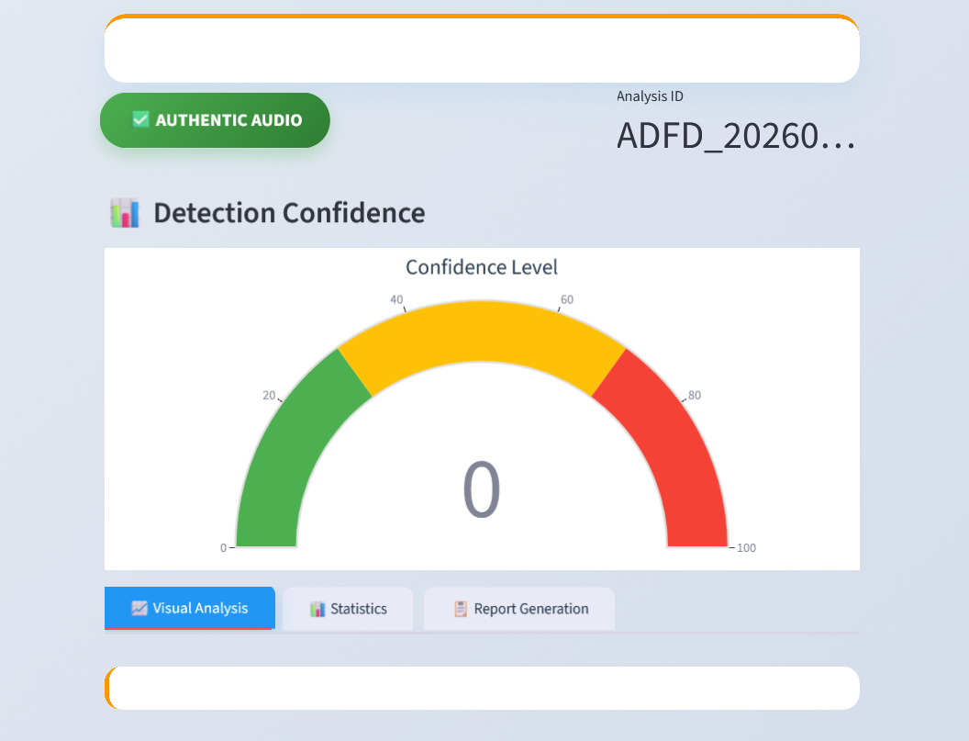
Screenshot
Real Audio
Notes:
2

Slide 17
Literature Survey
Existing Methods
CNN-based models use spectrogram features for deepfake detection
Handcrafted features (e.g., MFCC) used in traditional approaches
Self-supervised learning models extract advanced speech representations
Hybrid models (CNN + LSTM) improve detection performance
Notes:
2

Slide 18
Literature Survey
Limitations Identified
Poor generalization to unseen datasets
High computational complexity
Inability to capture temporal dependencies effectively
Reduced performance in real-time applications
Research Gap
Need for a lightweight, generalizable, and real-time deepfake audio detection system using advanced feature extraction and temporal modeling
Notes:
2

Slide 19
References
Ritushree bohara and Amit kumar bairwa, "Detecting Deepfake Audio Using Spectrogram-Based MachineLearning Approaches", vol. 13, pp. 149478-149489, Aug. 2025
A. Hamza, A. R. Javed, F. Iqbal, N. Kryvinska, A. S. Almadhor, Z. Jalil, and R. Borghol, “Deepfake Audio Detection via MFCC Features Using Machine Learning,” IEEE Access, vol. 10, pp. 134018–134028, 2022
T. M. Wani, S. A. A. Qadri, D. Comminiello, and I. Amerini, “Detecting Audio Deepfakes: Integrating CNN and BiLSTM with Multi-Feature Concatenation,” in Proc. ACM Workshop on Information Hiding and Multimedia Security (IH&MMSec ’24), 2024, pp. 271–276.S.
Al-Halabi and A. Kafri, “Audio Deepfake Detection Using a Hybrid Model of Convolutional and Bidirectional Long Short-Term Memory Networks,” Adv. Appl. Sci., vol. 11, no. 1, pp. 1–7, Jan. 2026.
N. Babiker Mohammed Babiker, “Deepfake Audio Detection in Voice Authentication: A Spectral and CNN-Based Comprehensive Review,” Eng. Technol. Appl. Sci. Res., vol. 15, no. 6, pp. 29824–29832, Dec. 2025
Notes:
2

Slide 20
References
Baoping Liu, Bo Liu, Tianqing Zhu, Ming Ding, A Review of Deepfake and Its Detection: From Generative Adversarial Networks to Diffusion Models, International Journal of Intelligent Systems, 2025.
David Ghiurău, Daniela Elena Popescu, Distinguishing Reality from AI: Approaches for Detecting Synthetic Content, Computers (MDPI), 2025.
Sarah Tipper, Hany F. Atlam, Harjinder Singh Lallie, An Investigation into the Utilisation of CNN with LSTM for Video Deepfake Detection, Applied Sciences, 2024.
Achhardeep Kaur, Azadeh Noori Hoshyar, Vidya Saikrishna, Selena Firmin, Feng Xia, Deepfake Video Detection: Challenges and Opportunities, Artificial Intelligence Review, 2024.
Zekun Sun, Na Ruan, Jianhua Li, DDL: Effective and Comprehensible Interpretation Framework for Diverse Deepfake Detectors, IEEE Transactions on Information Forensics and Security, 2025.
Notes:
2

Slide 21
Thank You

